Slide 1
Symfony 2
Imagina Formación

Slide 2
Tema 3
Gestión de la persistencia con Doctrine

Slide 3
3.1.
¿Qué es doctrine?

Slide 4
Doctrine es un Object Relational Mapper.
- Proporciona una capa de abstracción orientada a objetos.
- Facilita las migraciones.
- Ofrece métodos para manipular entidades.
Se incluye como vendor en Symfony Standard Edition pero NO es un componente de Symfony.

Slide 5
¡Ojo con el rendimiento! → conocer bien la herramienta

Slide 6
3.2.
Configuración

Slide 7
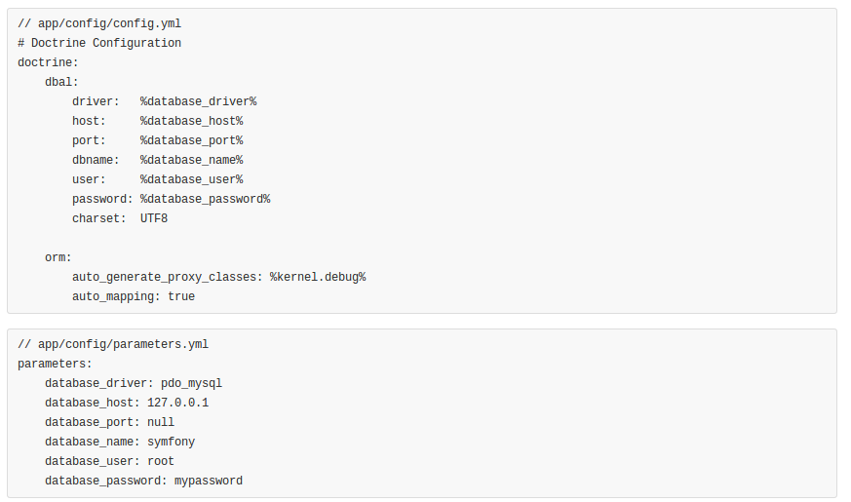
Archivos de configuración

Slide 8
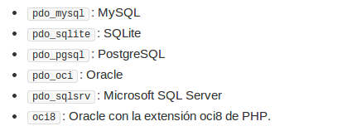
Drivers

Slide 9

Comandos de consola

Slide 10
3.3.
Entidades

Slide 11
Las entidades son los actores que modelan el sistema y requieren ser persistidos.

Slide 12
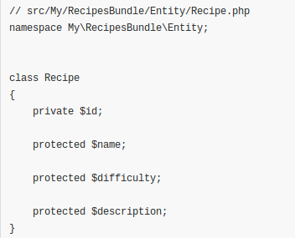
Definición

Slide 13
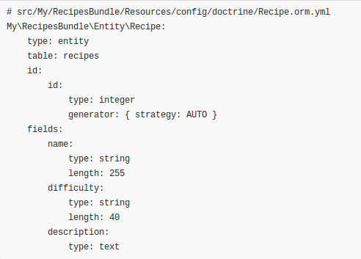
Mapeo
También es posible el mapeo con anotaciones y XML.

Slide 14
Comandos de consola
$ php app/console doctrine:schema:create --dump-sql
CREATE TABLE recipes (id INT AUTO_INCREMENT NOT NULL, name VARCHAR(40) NOT NULL, description LONGTEXT NOT NULL, PRIMARY KEY(id)) DEFAULT CHARACTER SET utf8 COLLATE utf8_unicode_ci ENGINE = InnoDB;
$ php app/console doctrine:schema:create
ATTENTION: This operation should not be executed in a production environment.
Creating database schema...
Database schema created successfully!

Slide 15
Comandos de consola (II)
$ app/console doctrine:generate:entities My/RecipesBundle/Entity/Recipe
Generating entity "My\RecipesBundle\Entity\Recipe"
> backing up Recipe.php to Recipe.php~
> generating My\RecipesBundle\Entity\Recipe
$ app/console doctrine:generate:entity

Slide 16
Persistir entidades
// src/My/RecipesBundle/Controller/DefaultController.php
use My\RecipesBundle\Entity\Recipe;
use Symfony\Component\HttpFoundation\Response;
public function createAction()
{
$recipe = new Recipe();
$recipe->setName('Pollo al pil-pil');
$recipe->setDificulty('fácil');
$recipe->setDescription('...');
$em = $this->getDoctrine()->getManager();
$em->persist($recipe);
$em->flush();
return new Response('Creada receta con id ' . $recipe->getId());
}

Slide 17
Recuperar entidades
// src/My/RecipesBundle/Controller/DefaultController.php
public function showAction($id)
{
$repository = $this->getDoctrine()
->getRepository('MyRecipesBundle:Recipe');
$recipe = $repository->find($id);
// ...
}
// src/My/RecipesBundle/Controller/DefaultController.php
public function showAction($id)
{
// …
$recipes = $repository->findAll();
$recipes = $repository->findBy(array('difficulty' => 'easy')); // filtrado
$recipes = $repository->findBy(array(), array('name' => 'DESC')); // ordenación
$recipes = $repository->findByDifficulty('easy');
$recipe = $repository->findOneByName('Pollo al pil-pil');
}

Slide 18
Actualizar entidades
$recipe = $repository->findOneByName('Pollo al pil-pil');
$recipe->setName('Pollo al chilindrón');
$this->getDoctrine()->getManager()->flush();

Slide 19
Eliminar entidades
$recipe = $repository->find($id);
$em = $this->getDoctrine()->getManager();
$em->remove($recipe);
$em->flush();

Slide 20
3.4.
Relaciones

Slide 21
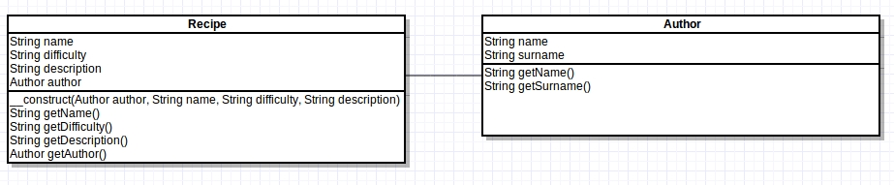
Entidades relacionadas

Slide 22
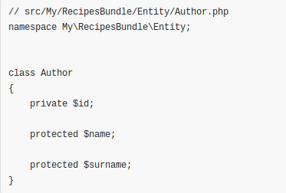
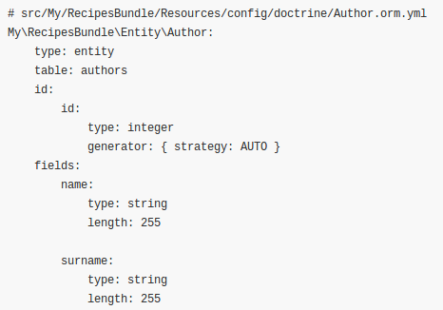
Entidades relacionadas (II)

Slide 23
Muchos a uno
// src/My/RecipesBundle/Entity/Recipe.php
class Recipe
{
// ...
protected $author;
}
# src/My/RecipesBundle/Resources/config/doctrine/Recipe.orm.yml
My\RecipesBundle\Entity\Recipe:
type: entity
table: recipes
manyToOne:
author:
targetEntity: Author
joinColumn:
name: author_id
referencedColumnName: id
# ...

Slide 24
Muchos a uno (II)
$ php app/console doctrine:schema:update --dump-sql
ALTER TABLE recipes ADD author_id INT DEFAULT NULL;
ALTER TABLE recipes ADD CONSTRAINT FK_A369E2B5F675F31B FOREIGN KEY (author_id) REFERENCES authors (id);
CREATE INDEX IDX_A369E2B5F675F31B ON recipes (author_id)

Slide 25
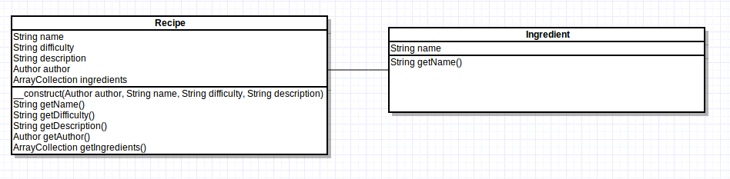
Muchos a muchos

Slide 26
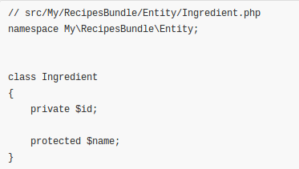
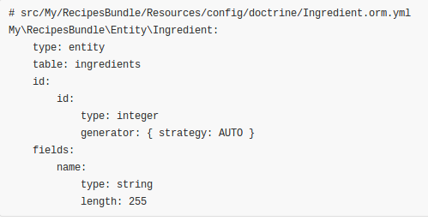
Muchos a muchos (II)

Slide 27
Muchos a muchos (III)
// src/My/RecipesBundle/Entity/Recipe.php
use Doctrine\Common\Collections\ArrayCollection;
class Recipe
{
// ...
protected $ingredients;
}
# src/My/RecipesBundle/Resources/config/doctrine/Recipe.orm.yml
My\RecipesBundle\Entity\Recipe:
type: entity
table: recipes
manyToMany:
ingredients:
targetEntity: Ingredient
joinTable:
name: recipe_ingredients
joinColumns:
recipe_id:
referencedColumnName: id
inverseJoinColumns:
ingredient_id:
referencedColumnName: id
# ...

Slide 28
Muchos a muchos (IV)
$ php app/console doctrine:schema:update --dump-sql
CREATE TABLE recipe_ingredients (recipe_id INT NOT NULL, ingredient_id INT NOT NULL, INDEX IDX_9F925F2B59D8A214 (recipe_id), INDEX IDX_9F925F2B933FE08C (ingredient_id), PRIMARY KEY(recipe_id, ingredient_id)) DEFAULT CHARACTER SET utf8 COLLATE utf8_unicode_ci ENGINE = InnoDB;
ALTER TABLE recipe_ingredients ADD CONSTRAINT FK_9F925F2B59D8A214 FOREIGN KEY (recipe_id) REFERENCES recipes (id);
ALTER TABLE recipe_ingredients ADD CONSTRAINT FK_9F925F2B933FE08C FOREIGN KEY (ingredient_id) REFERENCES ingredients (id)

Slide 29
Manipular relaciones
class Recipe
{
// ...
public function __construct(Author $author, $name, $description, $difficulty)
{
$this->author = $author;
$this->name = $name;
$this->description = $description;
$this->difficulty = $difficulty;
$this->ingredients = new ArrayCollection();
}
public function add(Ingredient $ingredient)
{
$this->ingredients[] = $ingredient;
}
}

Slide 30
Manipular relaciones (II)
public function createAction()
{
$em = $this->getDoctrine()->getEntityManager();
$author = new Author('Karlos', 'Arguiñano');
$em->persist($author);
$ingredient = new Ingredient('Pollo');
$em->persist($ingredient);
$recipe = new Recipe($author, 'Pollo al pil-pil', 'Deliciosa y económica receta.', 'fácil');
$em->persist($recipe);
$recipe->add($ingredient);
$em->flush();
return $this->redirect($this->generateUrl('my_recipes_show', array('id' => $recipe->getId())));
}

Slide 31
Manipular relaciones (III)
Por defecto, las entidades relacionadas deben persistirse por separado.

Slide 32
Operaciones en cascada
My\RecipesBundle\Entity\Recipe:
type: entity
table: recipes
manyToOne:
author:
# ...
cascade: ["persist"]
manyToMany:
ingredients:
# ...
cascade: ["persist"]
# ...

Slide 33
Operaciones en cascada (II)
public function createAction()
{
$author = new Author('Karlos', 'Arguiñano');
$ingredient = new Ingredient('Pollo');
$recipe = new Recipe($author, 'Pollo al pil-pil', 'Deliciosa y económica receta.', 'fácil');
$recipe->add($ingredient);
$this->persistAndFlush($recipe);
return $this->redirect($this->generateUrl('my_recipes_show', array('id' => $recipe->getId())));
}
private function persistAndFlush(Recipe $recipe)
{
$em = $this->getDoctrine()->getEntityManager();
$em->persist($recipe);
$em->flush();
}

Slide 34
Operaciones en cascada (III)
persist: Guardar entidades asociadas.
remove: Eliminar entidades asociadas.
merge: Combina entidades asociadas.
detach: Desvincula las entidades de sus equivalentes en la base de datos.
all: Todas las anteriores.

Slide 35
Relaciones bidireccionales
// Recuperar el autor de una receta
$repository = $this->getDoctrine()->getRepository('MyRecipesBundle:Recipe');
$recipe = $repository->find($id);
$author = $recipe->getAuthor();
// No es posible realizar el camino inverso
$repository = $this->getDoctrine()->getRepository('MyRecipesBundle:Author');
$author = $repository->find($id);
$recipes = $author->getRecipes();

Slide 36
Relaciones bidireccionales (II)
class Author
{
// ...
protected $recipes;
public function __construct($name, $surname)
{
//...
$this->recipes = new ArrayCollection;
}
public function getRecipes()
{
return $this->recipes;
}
}

Slide 37
Relaciones bidireccionales (III)
My\RecipesBundle\Entity\Author:
oneToMany:
recipes:
targetEntity: Recipe
mappedBy: author
My\RecipesBundle\Entity\Recipe:
manyToOne:
author:
inversedBy: recipes
// ...

Slide 38
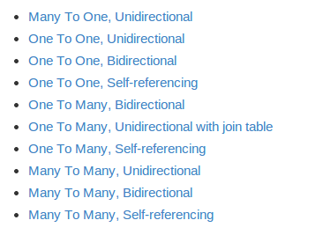
Otras relaciones

Slide 39
Fin del tema 3

